Slide 1

React Native
Learn Once…Write Everywhere…

Slide 2
Why React Native ???
We have Real native app.
Because all the UI don’t gets compiled into Native code.
JavaScript remains same.
But, all the UI elements will be changing depending upon the Platform Running On.
So it gives Better Performance.

Slide 3
Environmental setup
Follow this link ➔
https://facebook.github.io/react-native/docs/getting-started

Slide 4
First!!!
We will go with “Expo Cli Quickstart”

Slide 5
Why Expo tool?
Can develop app for all platform (iOS/Android) or any OS.
Easy sharing
No Xcode / Android studio required
Note :
Both System and Mobile Device should be in same Wi-Fi network connection.

Slide 6
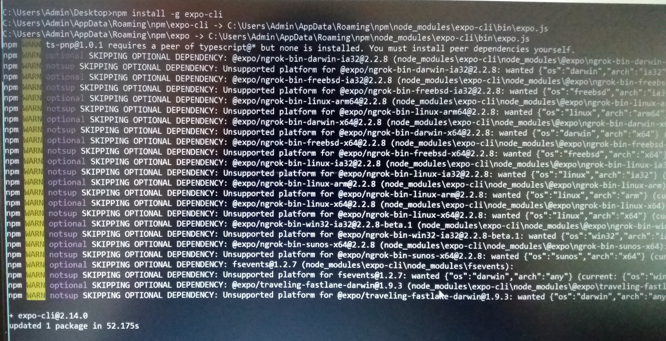
Environmental setup
➔Install node js 10 (latest version)
➔Install Visual Studio Code
➔Open Command Prompt and type
npm install -g expo-cli

Slide 7
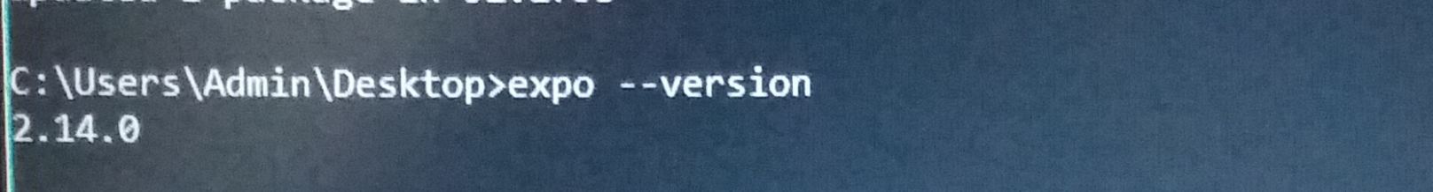
➔Check if Expo is successfully installed
expo –version

Slide 8
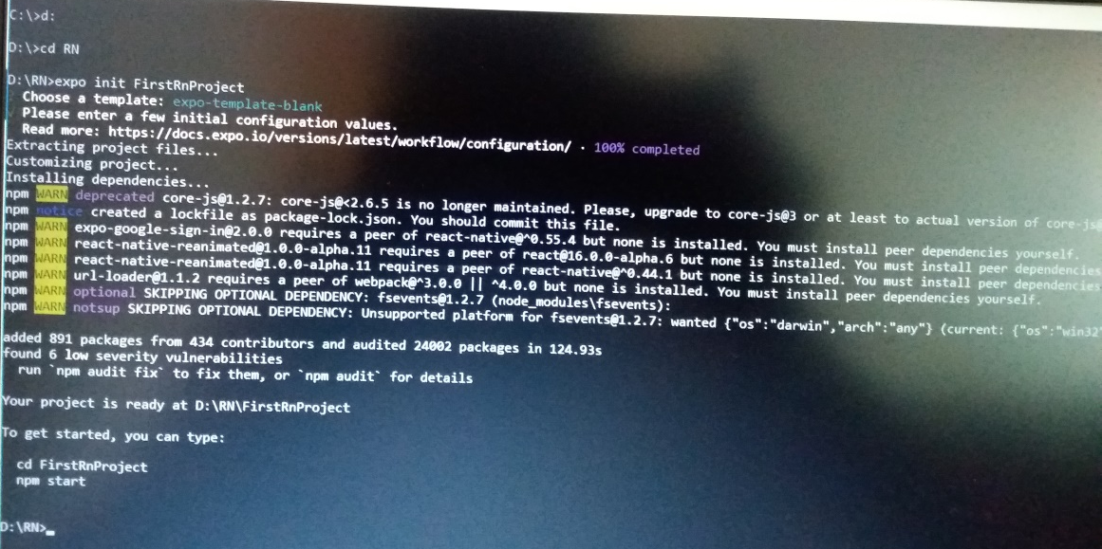
➔Create a new folder for your project and open that path in command Prompt
➔Creating new project
expo init MyFirstRnProject

Slide 9
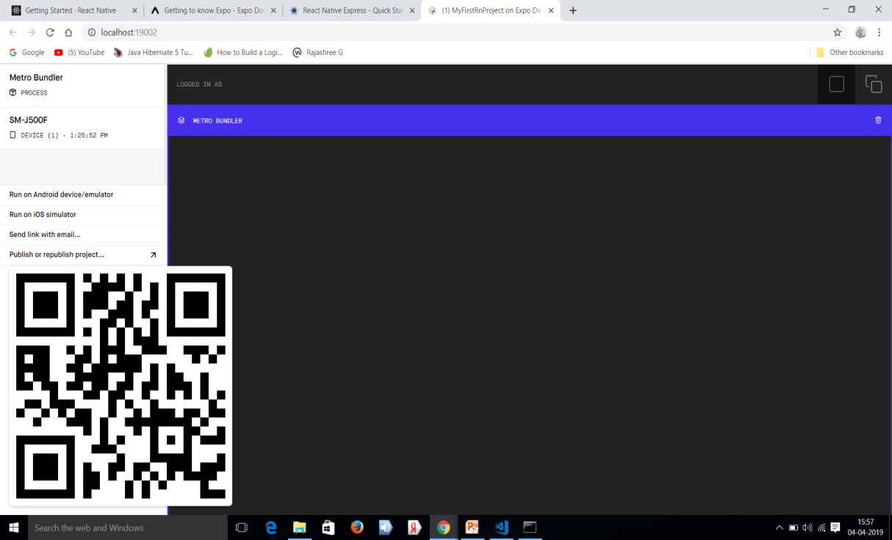
➔Open the Project Directory
cd MyFirstRnProject
npm start (or) expo start ➔ This will start a development server

Slide 10
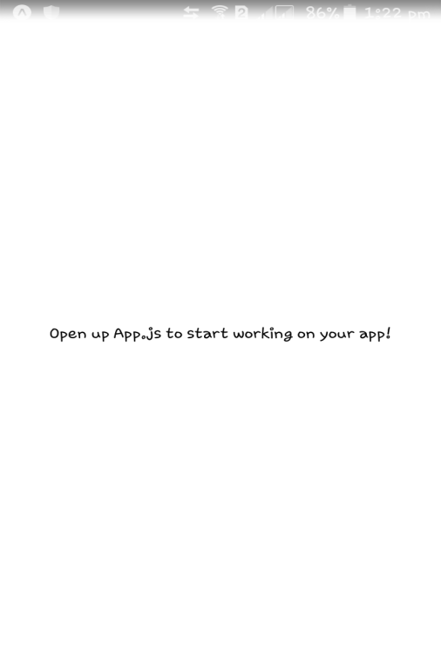
➔Download “Expo Client” app in your mobile device.
➔Scan the QR code of the server page and view it.

Slide 11

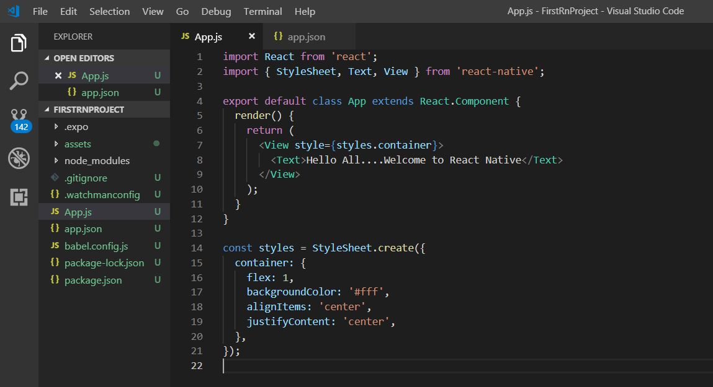
➔Now open App.js in Visual Studio Code
➔Edit the <Text> tag and see the changes in device.

